Slide 1


Fahad Muhammad
18/07/2024

Slide 2
Outline
Executive Summary P3
Summary of methodologies
Summary of results
Introduction P5
Methodology P6
Results P18
Conclusion P46

Slide 3

Executive Summary (methodologies)
The following methodology is used to address the factors for a successful rocket landing:
Collection of Data
SpaceX REST API and web scraping techniques
Wrangling of Data
data wrangling to create success/fail outcome variable
Visualization of data
exploration of data with the following factors are considered:
payload, launch site, flight number and yearly trend
Analysis of Data
the following statistics are obtained with SQL: total payload, payload range for successful launches, and total no. of successful and failed outcomes
Exploration of Data
launch site success rates and proximity to geographical markers
Visualization
Visualize the launch sites with the most success and successful payload ranges
Model Building
Build Models to predict landing outcomes using
logistic regression,
support vector machine (SVM),
decision tree
and K-nearest neighbor (KNN)

Slide 4
Executive Summary (results)
Exploratory Data Analysis:
Launch success has improved over time
KSC LC-39A has the highest success rate among landing sites
Orbits ES-L1, GEO, HEO, and SSO have a 100% success rat
Visualization/Analytics:
Most launch sites are near the equator
and all are close to the coast
Predictive Analytics:
All models performed similarly on the test set.
The decision tree model has outperformed

Slide 5
Introduction
Project background and context
This project circles around the successful landing prediction of Falcon 9.
SpaceX advertises Falcon 9 rocket launches on its website with a cost of 62 million dollars;
other providers cost upward of 165 million dollars each, much of the savings is because SpaceX can reuse the first stage.
Therefore if we can determine if the first stage will land, we can determine the cost of a launch.
This information can be used if an alternate company wants to bid against SpaceX for a rocket launch.
Problems to address
What are the factors for the success of rocket landing?
How payload mass, launch site, number of flights, and orbits affect first-stage landing success ?
How much is the rate of successful landings over time ?
Can we predict some model for successful landing (binary classification) ?

Slide 6

Section 1

Slide 7
Methodology (Executive Summary)
Data collection methodology
data is collected by REST API and web scraping techniques
Perform data wrangling
Ignore irrelevant columns, applying one hot encoding
Perform exploratory data analysis (EDA) using visualization and SQL
Various graphs and charts are constructed to depict relationship between variables to dig hidden facts in data
Perform interactive visual analytics
Use of API Folium and Plotly Dash to promote understanding
Perform predictive analysis using classification models
Build models and calculate accuracy of model

Slide 8
Data Collection – (Steps Performed)
Data is collected by Rest API and web scraping technique
by using REST API
1 call specialized SpaceX REST API
2 receive response in JSON
3 Normalize data into flat file
by web scraping techniques
1 get HTML response from Wiki
2 extract data using beautiful soup
3 Normalize data into flat file

Slide 9
Data Collection SpaceX API
CALL
API
REPONSE IN JSON
NORMALIZE
data
call specialized SpaceX REST API
receive response in JSON
Normalize data into flat file
A) clean data
B) build dictionary and data frame
C) Filter data frame
D) Export data to CSV file
Git link

Slide 10
Data Collection - Scraping
By using web scraping techniques​
1 get HTML response from Wiki​
2 Build beautifulSoup object
3 Build Data from soup
​ A. Find required table
B. Get desired columns
C. Create Dictionary of colums
D. Append data to keys
E. Assign Dictionary to DataFrame
F. Register DataFrame to CSV file
Extract data
get HTML
Build soup object
git link

Slide 11
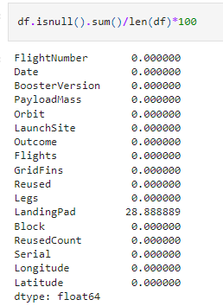
Data Wrangling
Example from case study:
Identify and calculate the percentage of the
missing values in each attribute
Perform EDA and determine data labels
Calculate the desired output values
Create binary for dependant variable
Export Data to CSV file
git link

Slide 12
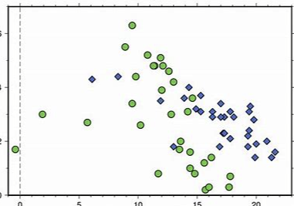
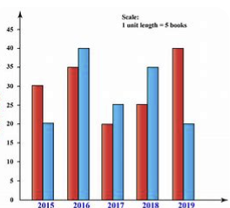
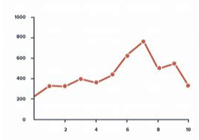
EDA with Data Visualization
Scatter Graphs
Various scatter graphs are build to visualize
Flight_no Vs Payload Mass, Flight_no Vs Launch Site,
Payload vs Launch Site, Orbit vs Payload Mass, etc.
Bar Graph
Mean vs. Orbit
Line Graph
Success Rate vs Year
git link

Slide 13
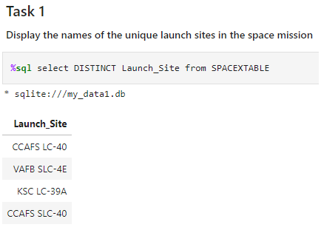
EDA with SQL
Display
Displaying the names of the unique launch sites in the space mission
Displaying 5 records where launch sites begin with the string 'KSC’
Displaying the total payload mass carried by boosters launched by NASA (CRS)
Displaying average payload mass carried by booster version F9 v1.1 …etc
Example from case study
List
Listing the date where the successful landing outcome in drone ship was achieved.
Listing the names of the boosters which have success in ground pad and have payload mass greater than 4000 but less than 6000
Listing the total number of successful and failure mission outcomes
Listing the names of the booster_versions which have carried the maximum payload mass ….etc
Git link

Slide 14
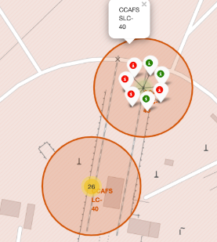
Build an Interactive Map with Folium
Launch success rate may depend on the location and proximity of a launch site. Folium Interactive Map was used for visualizing and analyzing SpaceX Launch Sites.
TASK 1: Mark all launch sites on a map
TASK 2: Mark the success/failed launches for each site on the map
TASK 3: Calculate the distances between a launch site to its proximities
git link

Slide 15
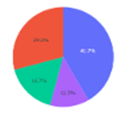
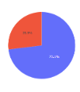
Build a Dashboard with Plotly Dash
After visual analysis using the dashboard, we are able to obtain some insights to answer the following five questions:
Which site has the largest successful launches?
Which site has the highest launch success rate?
Which payload range(s) has the highest launch success rate?
Which payload range(s) has the lowest launch success rate?
Which F9 Booster version (v1.0, v1.1, FT, B4, B5, etc.) has the highest launch success rate?
git link

Slide 16
Predictive Analysis (Classification)
Create Numpy arr from class column
Standardize the data with Standard Scaler
Split data into train and test
Create GridSearchCV object
Apply ML algo to calculate score
Build confusion matrix
Identify which model is best
Git link

Slide 17
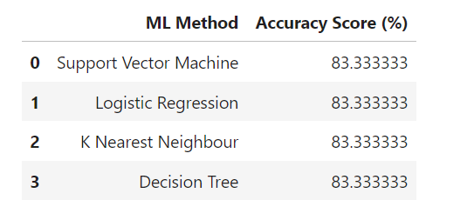
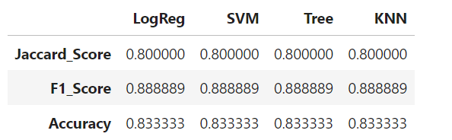
Results
Best model is DecisionTree with a score of 0.875 Best params is : {'criterion': 'entropy', 'max_depth': 2, 'max_features': 'log2', 'min_samples_leaf': 2, 'min_samples_split': 10, 'splitter': 'best'}

Slide 18

Section 2

Slide 19
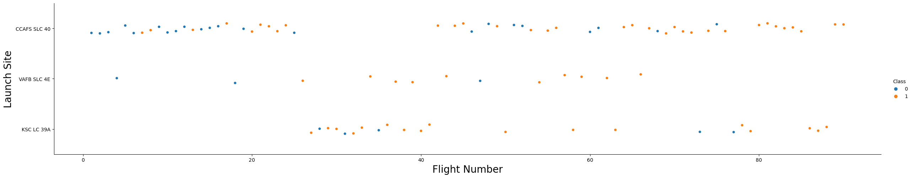
Flight Number vs. Launch Site
By using the function catplot to plot FlightNumber vs LaunchSite, the parameter x FlightNumber, the y Launch Site and the parameter hue as 'class'

Slide 20
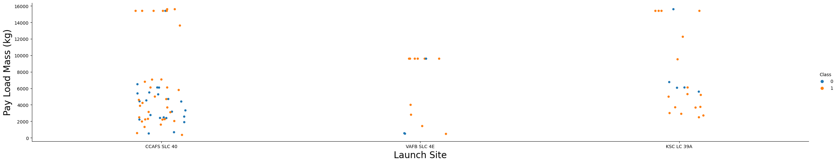
Payload vs. Launch Site
a scatter point chart with x axis Pay Load Mass (kg) and y axis the launch site, and hue to be the class value

Slide 21
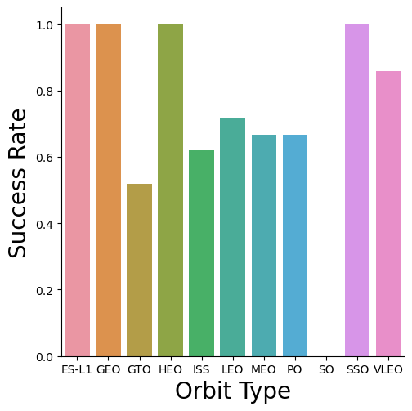
Success Rate vs. Orbit Type
relationship between success rate and orbit type

Slide 22
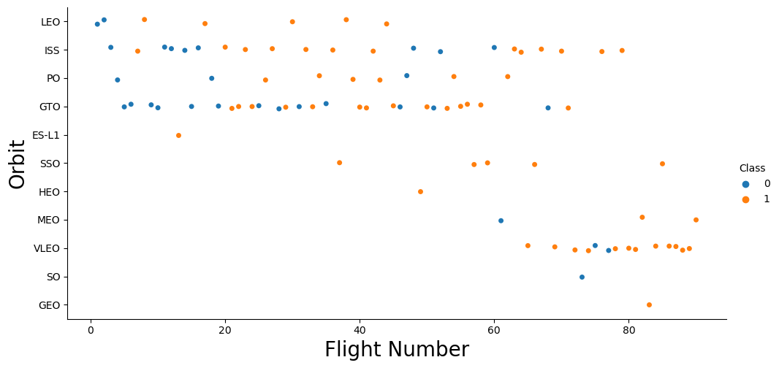
Flight Number vs. Orbit Type

Slide 23
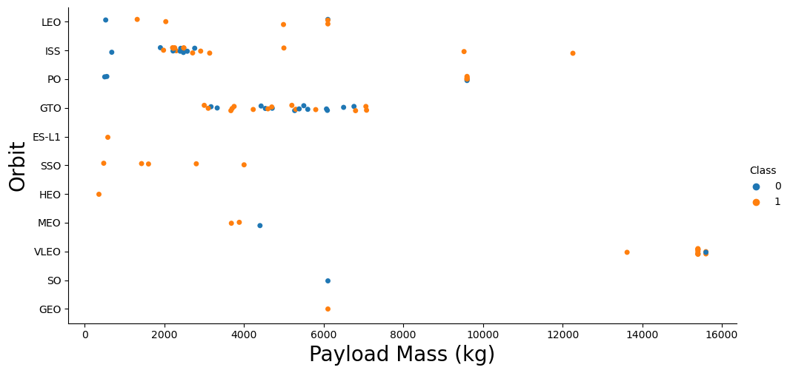
Payload vs. Orbit Type

Slide 24
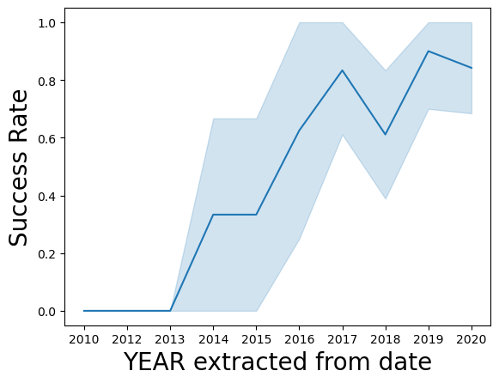
Launch Success Yearly Trend

Slide 25
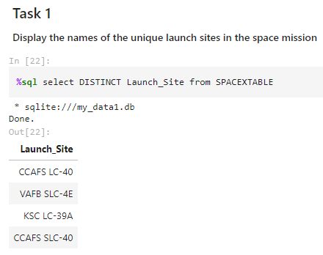
All Launch Site Names
Task Description=>
Sql query =>
Result =>

Slide 26
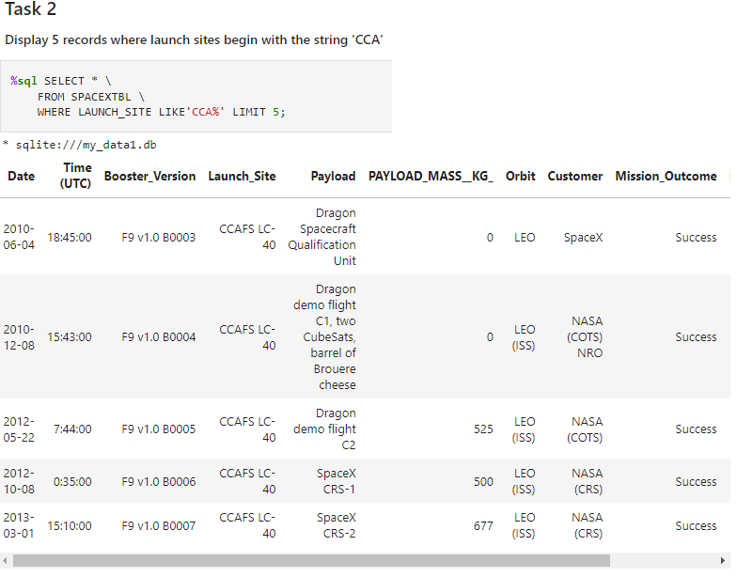
Launch Site Names Begin with 'CCA'
Task Description=>
Sql query =>
Result =>

Slide 27
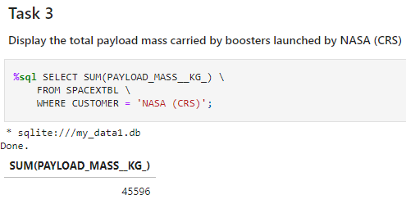
Total Payload Mass
Task Description=>
Sql query =>
Result =>

Slide 28
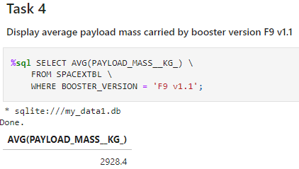
Average Payload Mass by F9 v1.1
Task Description=>
Sql query =>
Result =>

Slide 29
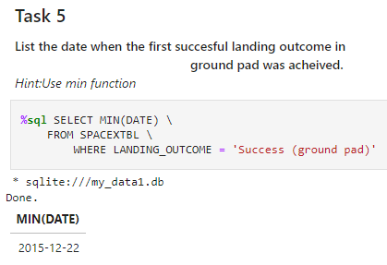
First Successful Ground Landing Date
Task Description=>
Sql query =>
Result =>

Slide 30
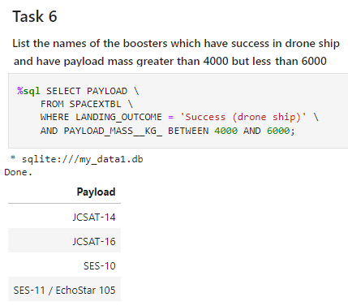
Successful Drone Ship Landing with Payload between 4000 and 6000
Task Description=>
Sql query =>
Result =>

Slide 31
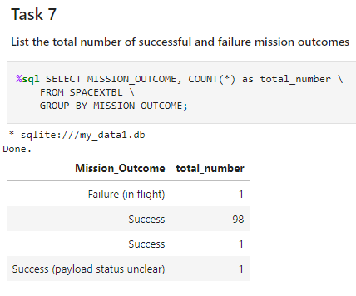
Total Number of Successful and Failure Mission Outcomes
Task Description=>
Sql query =>
Result =>

Slide 32
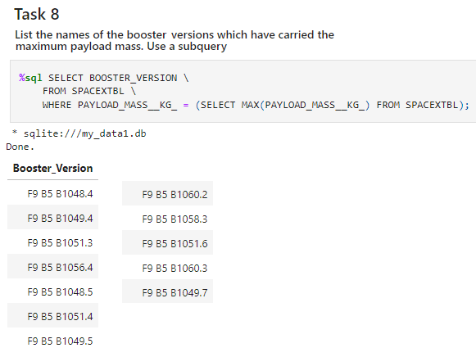
Boosters Carried Maximum Payload
Task Description=>
Sql query =>
Result =>

Slide 33
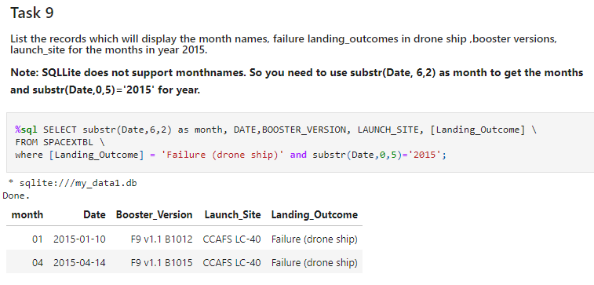
2015 Launch Records
Task
Description=>
Sql query =>
Result =>

Slide 34
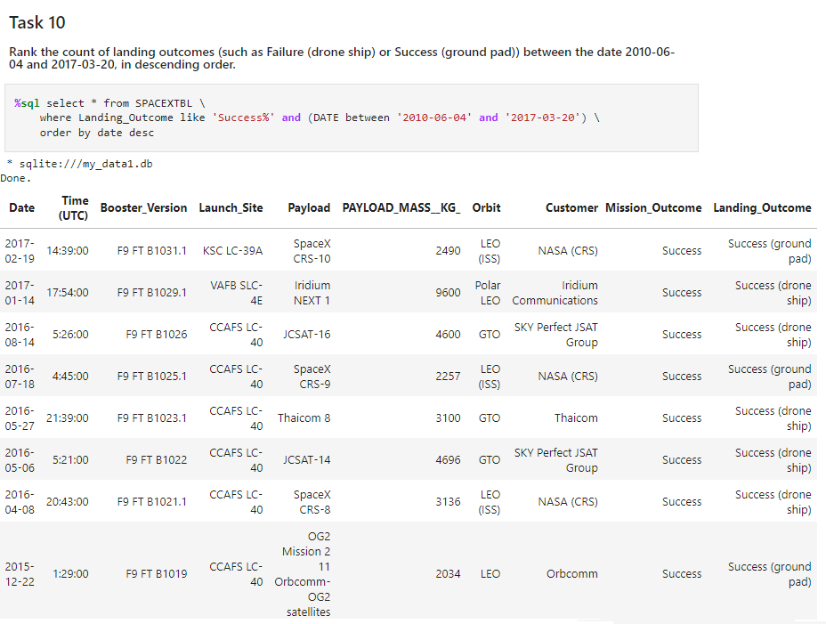
Rank Landing Outcomes Between 2010-06-04 and 2017-03-20
Task Description=>
Sql query =>
Result =>

Slide 35

Section 3

Slide 36
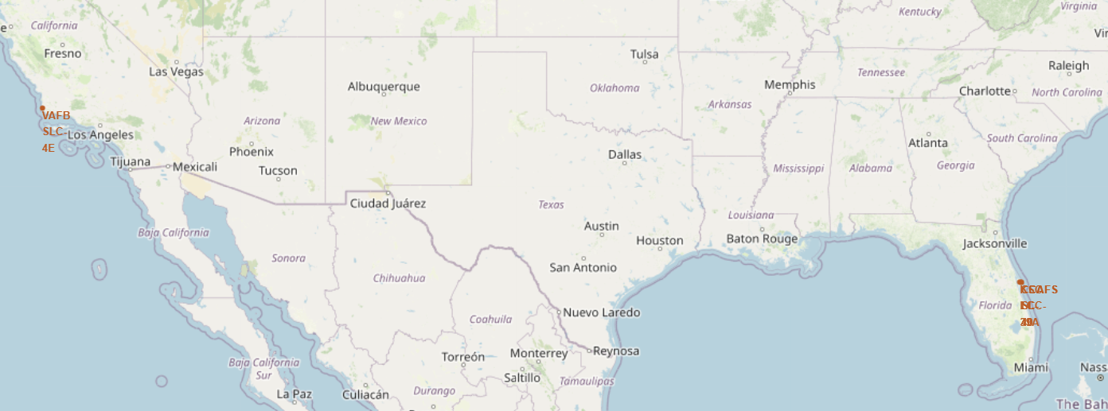
Markers - Launch Sites
Near Equator: the closer the launch site to the equator, the easier it is to launch to equatorial orbit, and the more help you get from Earth's rotation for a prograde orbit.
Rockets launched from sites near the equator get an additional natural boost - due to the rotational speed of earth - that helps save the cost of putting in extra fuel and boosters.

Slide 37
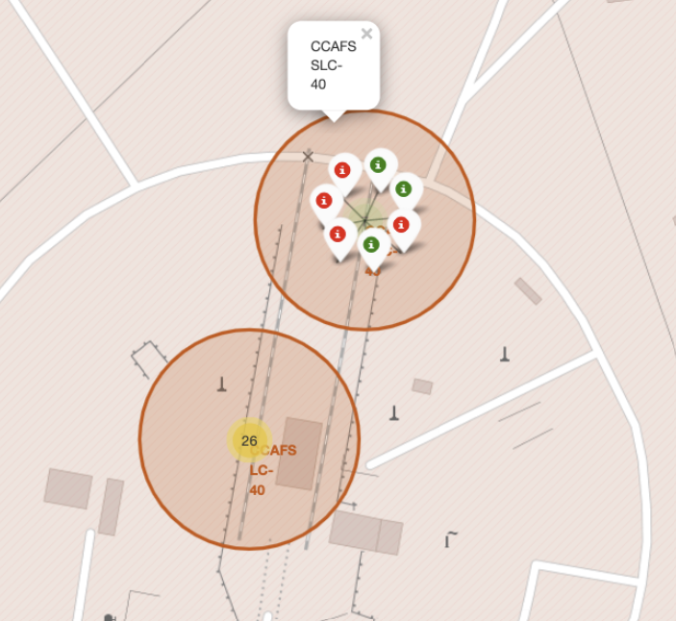
Successful and unsuccessful Launch outcomes
Green markers for successful launches
• Red markers for unsuccessful launches

Slide 38
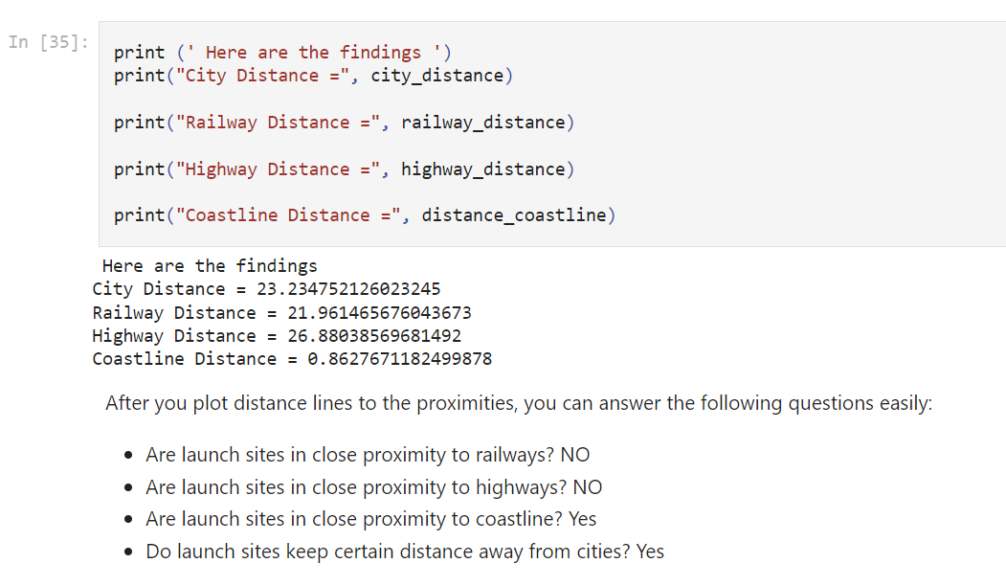
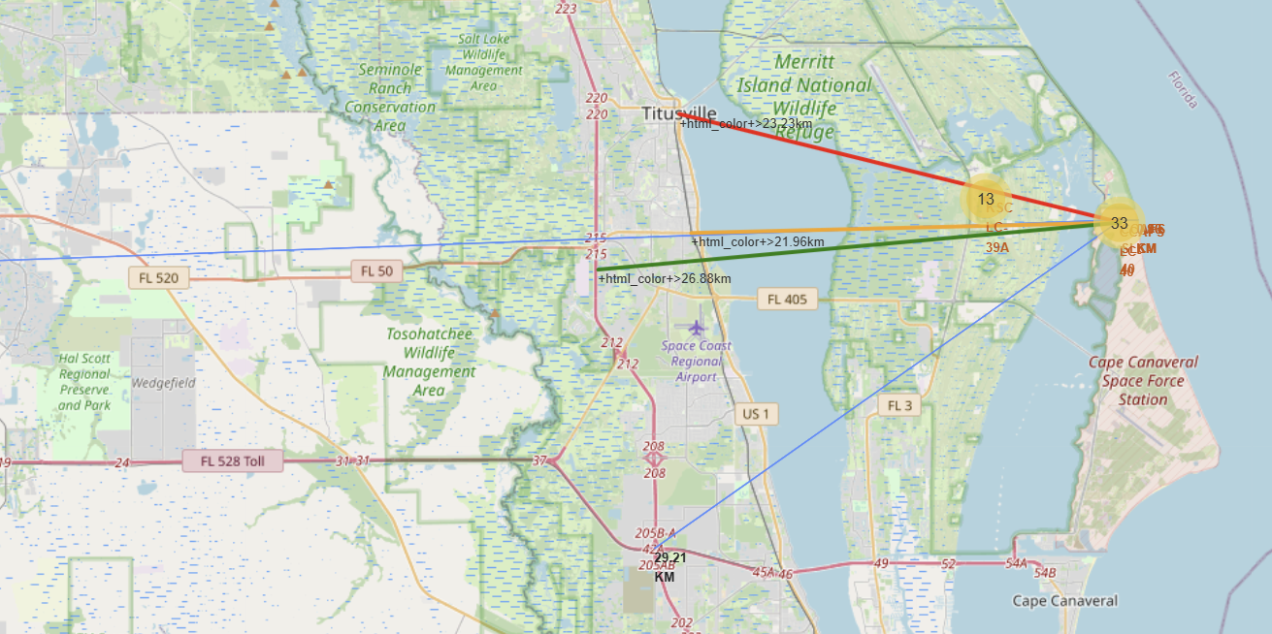
Distance Lines to the proximities and finding

Slide 39

Section 4

Slide 40
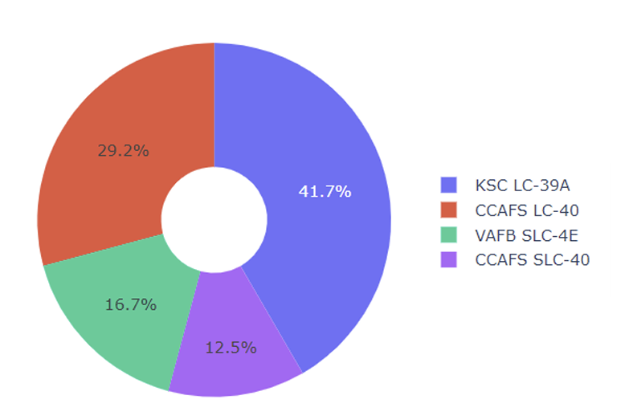
Launch Records on Pie Chart
Percentage show
the launch record

Slide 41
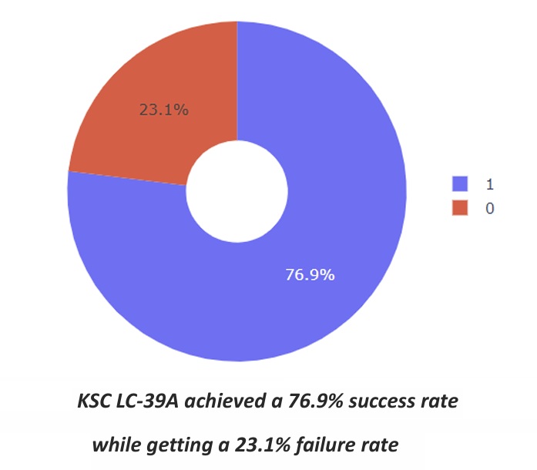
Success/failure of KSC LC-39A

Slide 42
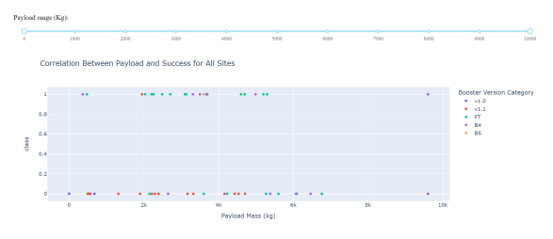
Payload Mass and Success

Slide 43

Section 5

Slide 44
Classification Accuracy
Same accuracy score achieved
Best model is DecisionTree with a score of 0.875 Best params is : {'criterion': 'entropy', 'max_depth': 2, 'max_features': 'log2', 'min_samples_leaf': 2, 'min_samples_split': 10, 'splitter': 'best'}

Slide 45
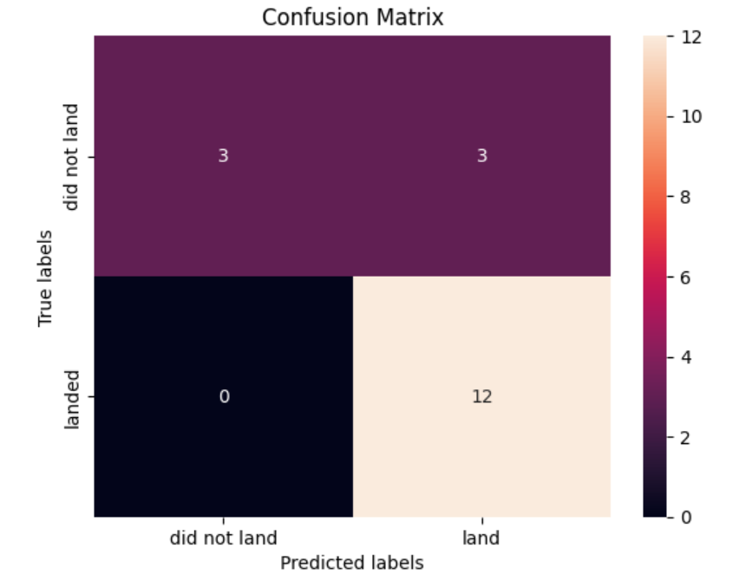
Confusion Matrix
A confusion matrix summarizes the performance of a classification algorithm
Same results are achieved for various models under observation

Slide 46
Conclusions
Distance Measurement: Most of the launch sites are near the equator for an additional natural boost - due to the rotational speed of earth - which helps save the cost of putting in extra fuel and boosters All the launch sites are close to the coast
Launch Success: Increases over time
KSC LC-39A:
Has the highest success rate among launch sites.
Has a 100% success rate for launches less than 5,500 kg
Orbits: ES-L1, GEO, HEO, and SSO have a 100% success rate
Payload Mass: Across all launch sites, the higher the payload mass (kg), the higher the success rate
Various models are tested with similar results; but decision tree has outperformed
The models performed similarly on the test set with the decision tree model slightly outperforming

Slide 47


